Slide 1



Customer Feedback Analysis and Improvement
Prepared BY:
Heba Zein
Kerolos Fawzy
Radwa
Mohamed Gamal
Mohamed AL Dawy

Slide 2
Customer Feedback Analysis and Improvement
Objective: Leveraging Data Engineering to analyze customer feedback and improve Customer Satisfaction.
Scope: Data Collection, Data Storage, Data Processing, Sentiment Analysis, and Improvement Suggestions.
Technologies Used:
Python (Pandas, NLTK, Scikit-learn, SpaCy)
Azure (Azure SQL, Azure Data Studio, Blob storage, Azure Synapse Analytics, Azure Data Factory)
Data Integration (ETL, Data Warehousing)

Slide 3
Customer Feedback Analysis and Improvement
Dataset Source: "Invistico_Airline.csv" (Customer feedback data for an airline service).
kaggle.com
Key Columns:
Customer Satisfaction
Sentiment Score
Customer Type
Age, Gender
Flight Class
Flight Departure and Arrival Delay
Sentiment Label (Positive, Negative, Neutral)
Data Challenges: missing data, outliers, or inconsistencies.

Slide 4
Customer Feedback Analysis and Improvement
Architecture Overview:
Bronze Layer (Staging): Loading raw customer feedback data into Azure SQL database.
Silver Layer (Cleansed Data): Preprocessing the data (removing nulls, duplicates, normalizing).
Gold Layer (Final Analytics): Organizing the data into a star schema to enable fast analysis.
ETL Process: Python is used for data extraction and transformation, and then it is loaded into the Azure SQL database.

Slide 5
Customer Feedback Analysis and Improvement
Data Extractin & Loading
Tools Used: SSMS, Azure Data Studio, SQL Database .
Steps:
Extracting data from CSV file and load it to SQL database.
Creating queries to extract and summarize feedback data

Slide 6
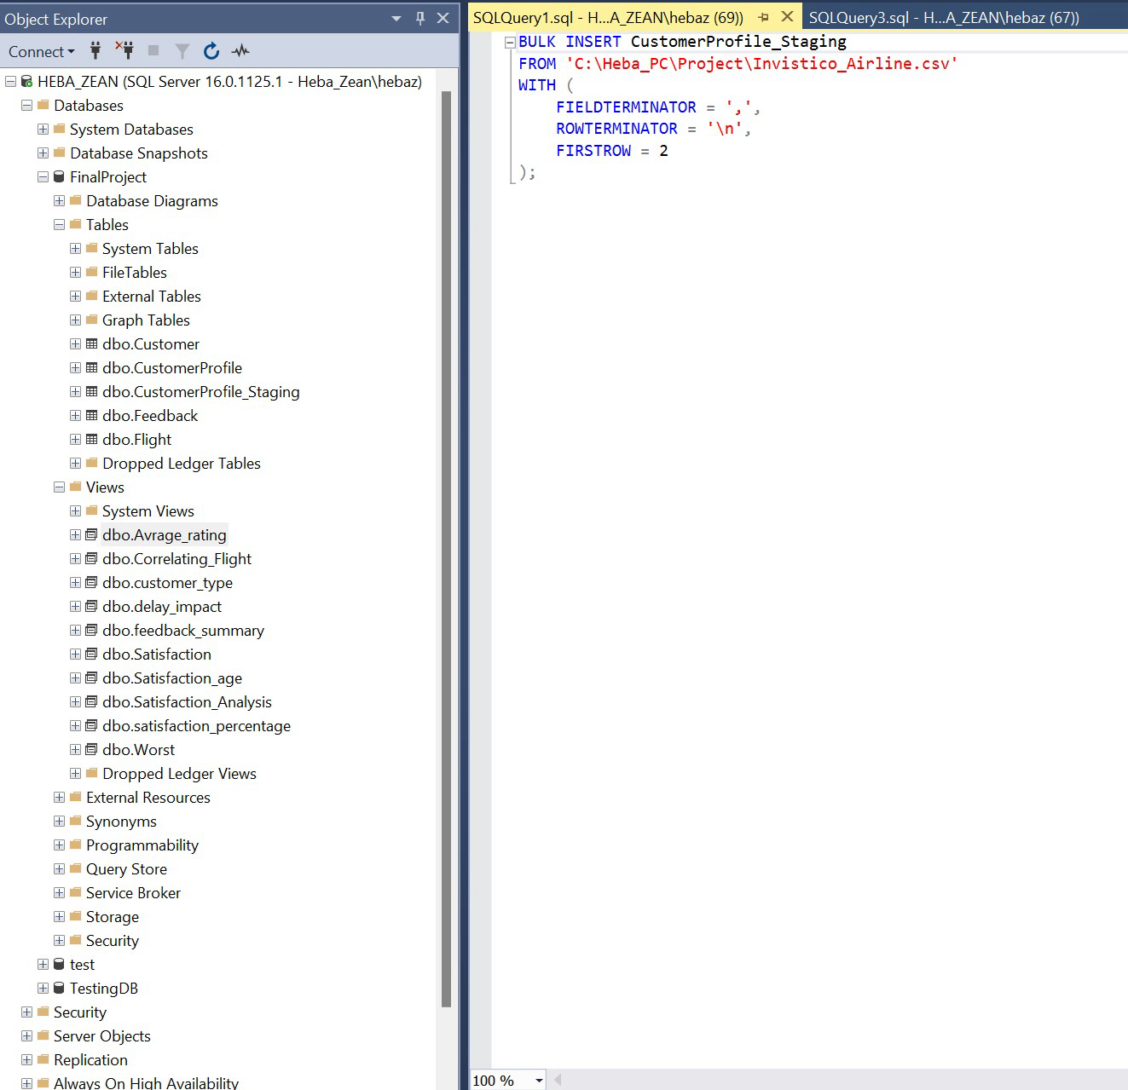
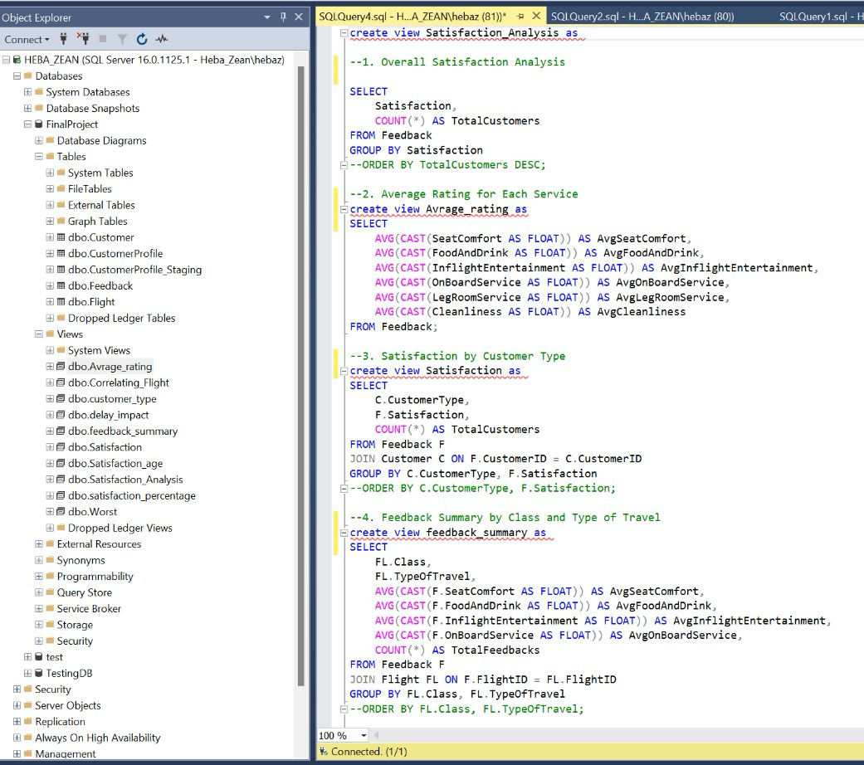
Customer Feedback Analysis and Improvement

Slide 7
Customer Feedback Analysis and Improvement
SQL Queries (Views)
1.⁠ ⁠Overall Satisfaction Analysis
2.⁠ ⁠Average Rating for Each Service
3.⁠ ⁠Satisfaction by Customer Type
4.⁠ ⁠Feedback Summary by Class and Type of Travel
5.⁠ ⁠Top 5 Worst-Rated Services
6.⁠ ⁠Delays Impact on Satisfaction
7.⁠ ⁠Satisfaction by Age Group
8.⁠ ⁠Correlating Flight Distance with Service Ratings
9.⁠ ⁠Customer Type Satisfaction for Delayed Flights
10.⁠ ⁠Percentage of Satisfied Customers

Slide 8
Customer Feedback Analysis and Improvement
Data Cleaning and Preprocessing
Tools Used: Python libraries such as Pandas and NLTK.
Steps:
Handle missing values (fill or drop).
Text preprocessing for feedback (tokenization, stopword removal, and stemming).
Sentiment tagging (positive, neutral, negative).

Slide 9
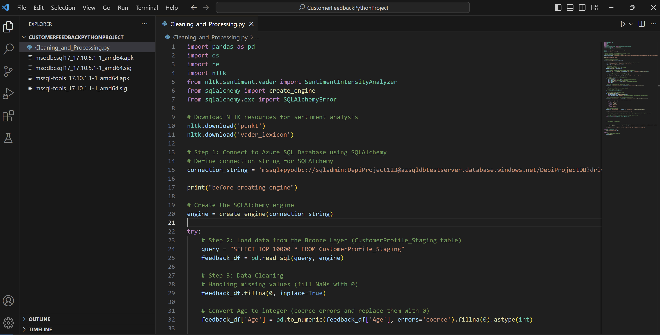
Customer Feedback Analysis and Improvement

Slide 10
Customer Feedback Analysis and Improvement
Sentiment Analysis (Python Implementation)
Sentiment Analysis Model: Explain the approach taken:
Natural Language Toolkit (NLTK) for text cleaning and sentiment tagging.
Scikit-learn for training sentiment classification models.
Potential use of SpaCy for more advanced NLP processing.
Visualization: Show sample Python code for sentiment analysis and highlight the key libraries used.
Outcome: Describe how sentiment analysis helped classify customer feedback into categories (positive, neutral, negative).

Slide 11
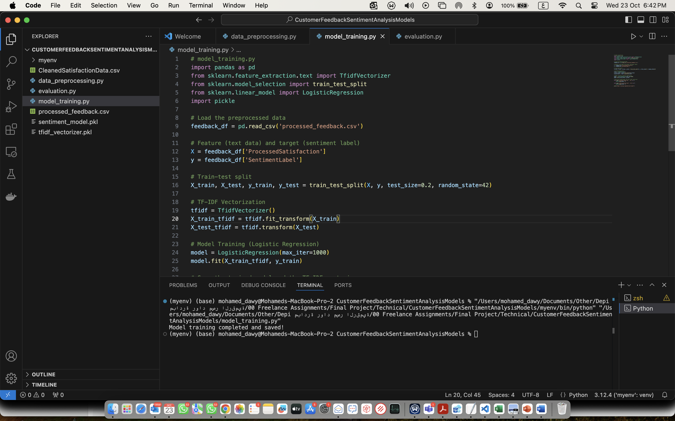
Customer Feedback Analysis and Improvement

Slide 12
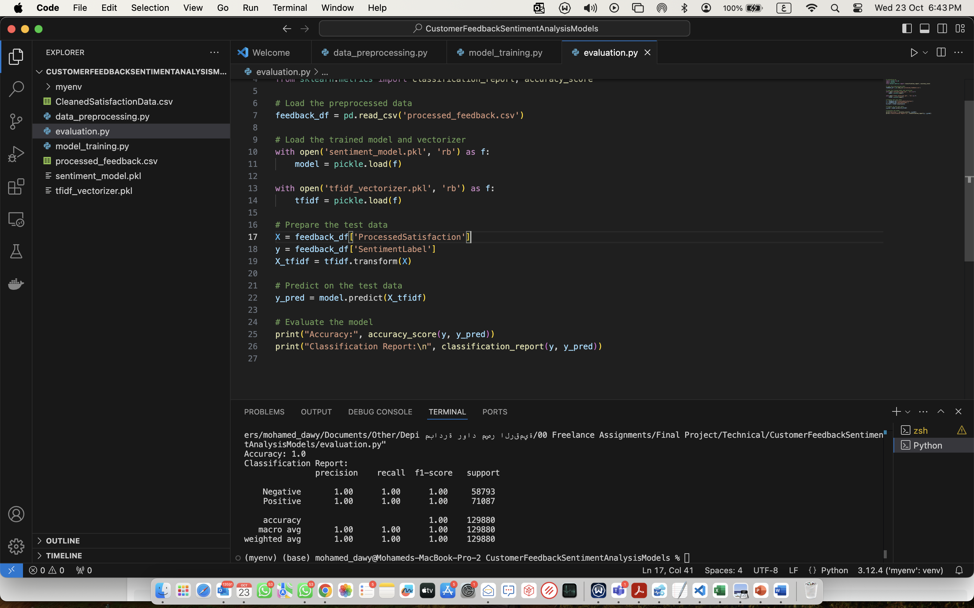
Customer Feedback Analysis and Improvement

Slide 13
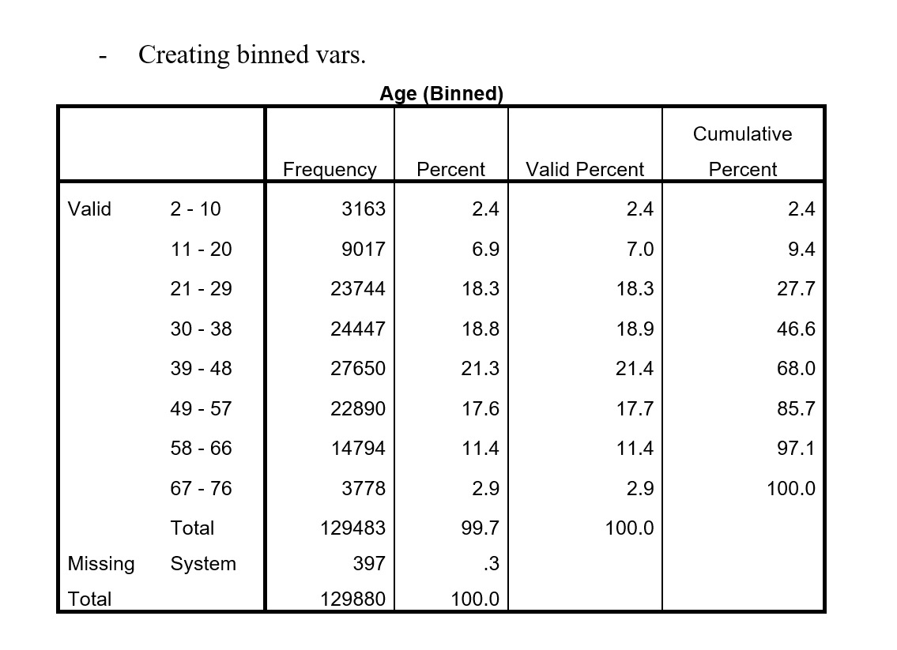
Customer Feedback Analysis and Improvement

Slide 14
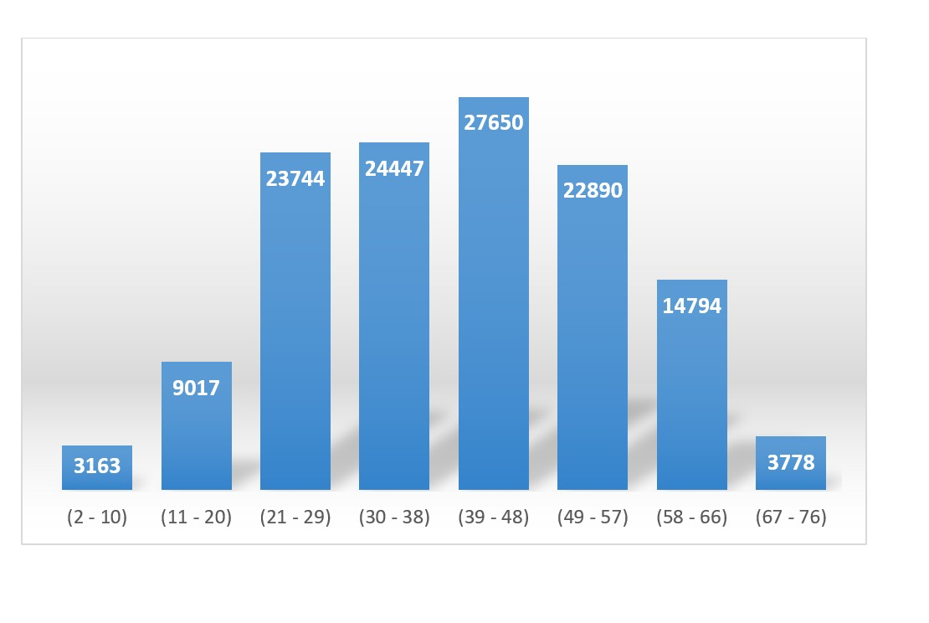
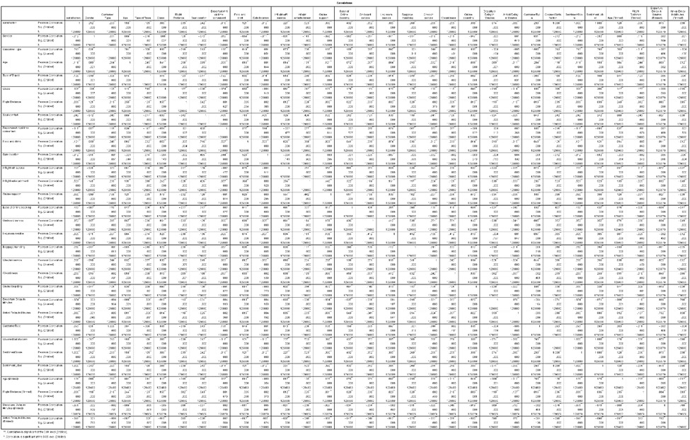
Customer Feedback Analysis and Improvement

Slide 15
Customer Feedback Analysis and Improvement
Azure Integration
Azure SQL Database: Storing feedback data for easy retrieval and querying.
Data Warehousing: Leveraging Azure Data Studio for building and managing the data warehouse (following the star schema for analysis).

Slide 16
Customer Feedback Analysis and Improvement
Results and Insights
Key Metrics:
Overall customer satisfaction distribution (positive, neutral, negative).
Sentiment by customer type (e.g., loyal vs. new customers).
Sentiment trends by age group, gender, or flight class.
Visualizations: Present charts and graphs that visualize the findings (Python Matplotlib/Seaborn or Power BI for more advanced visuals).
Improvement Suggestions: Based on the sentiment analysis, suggest possible improvements in customer service.

Slide 17
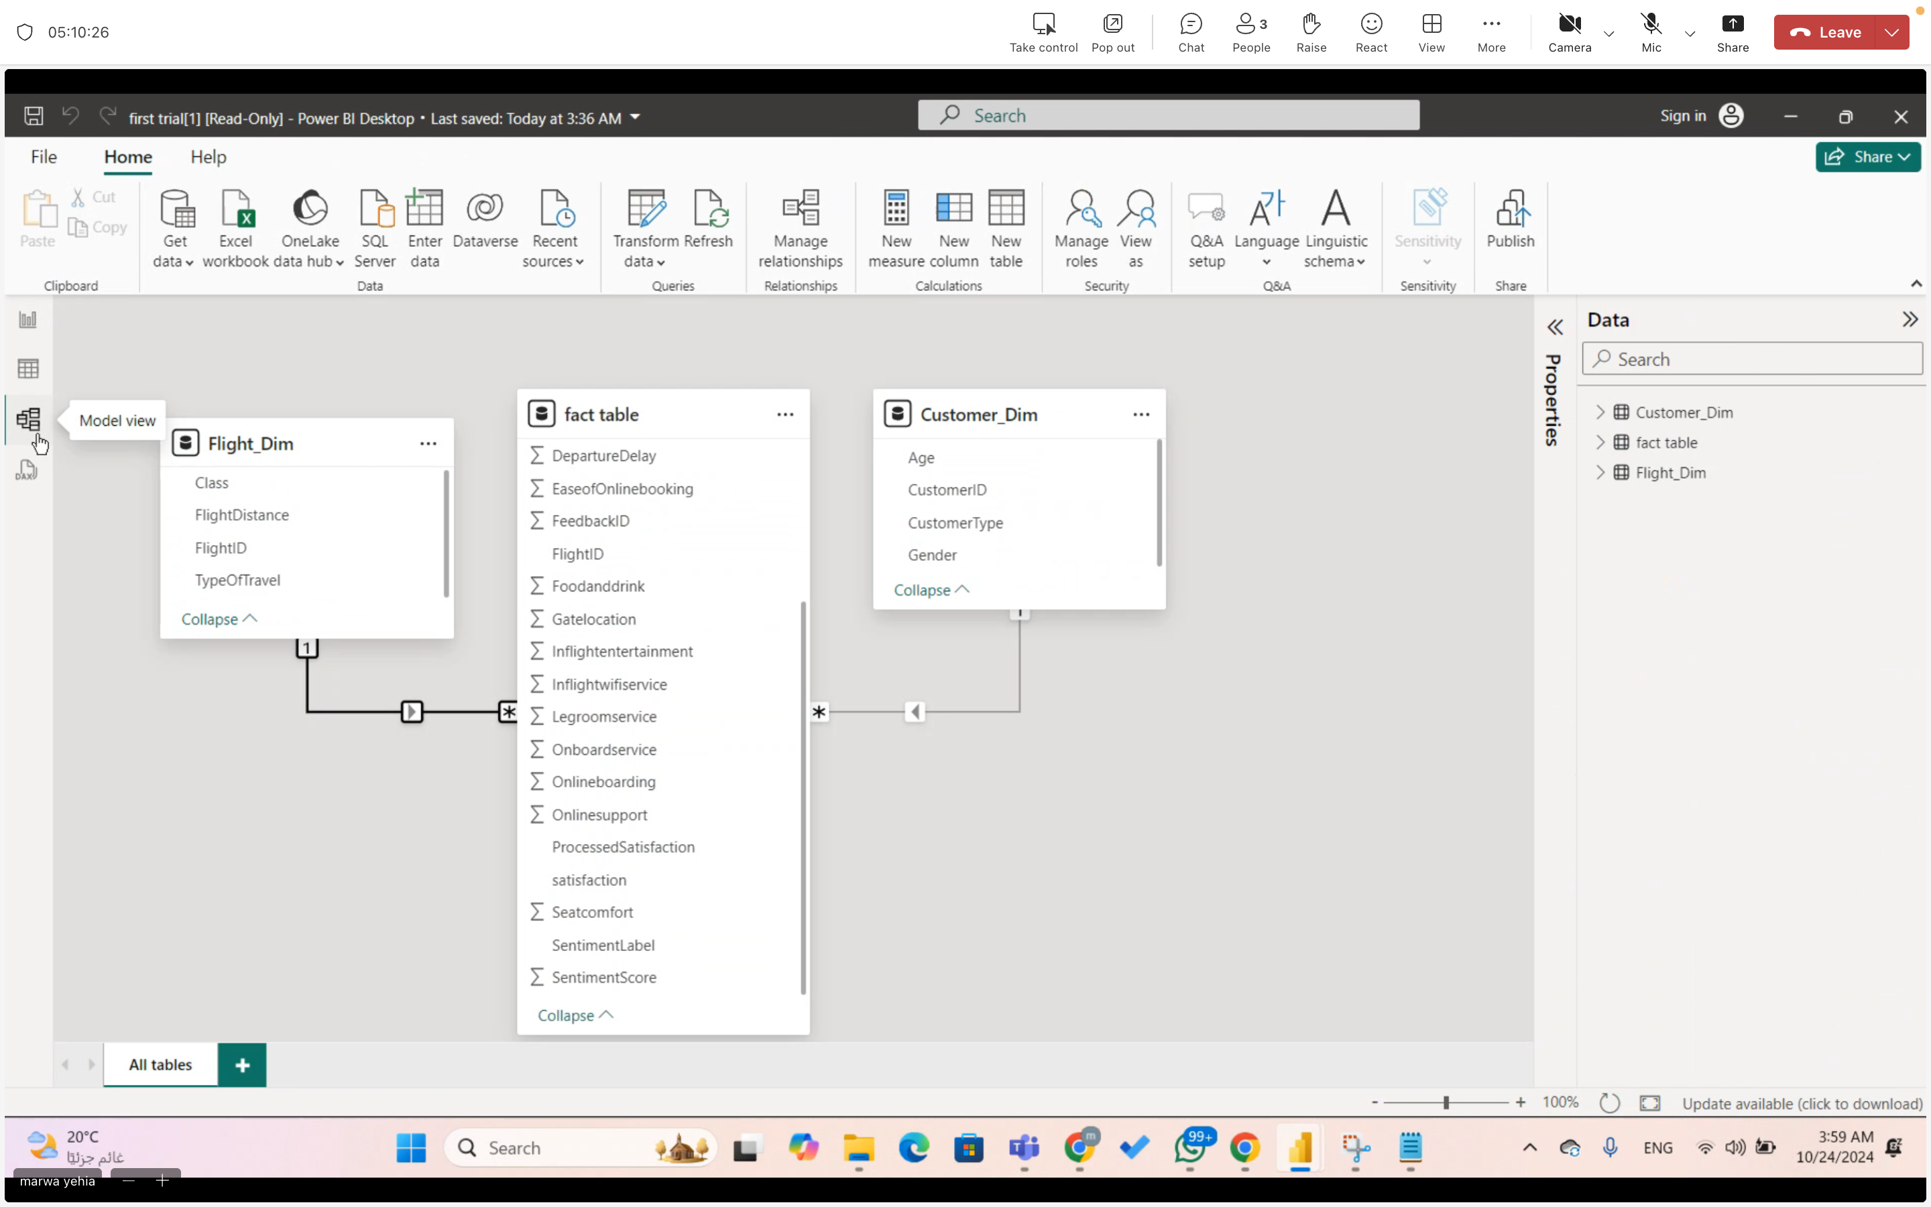
Customer Feedback Analysis and Improvement
Data Visualization
Power BI

Slide 18
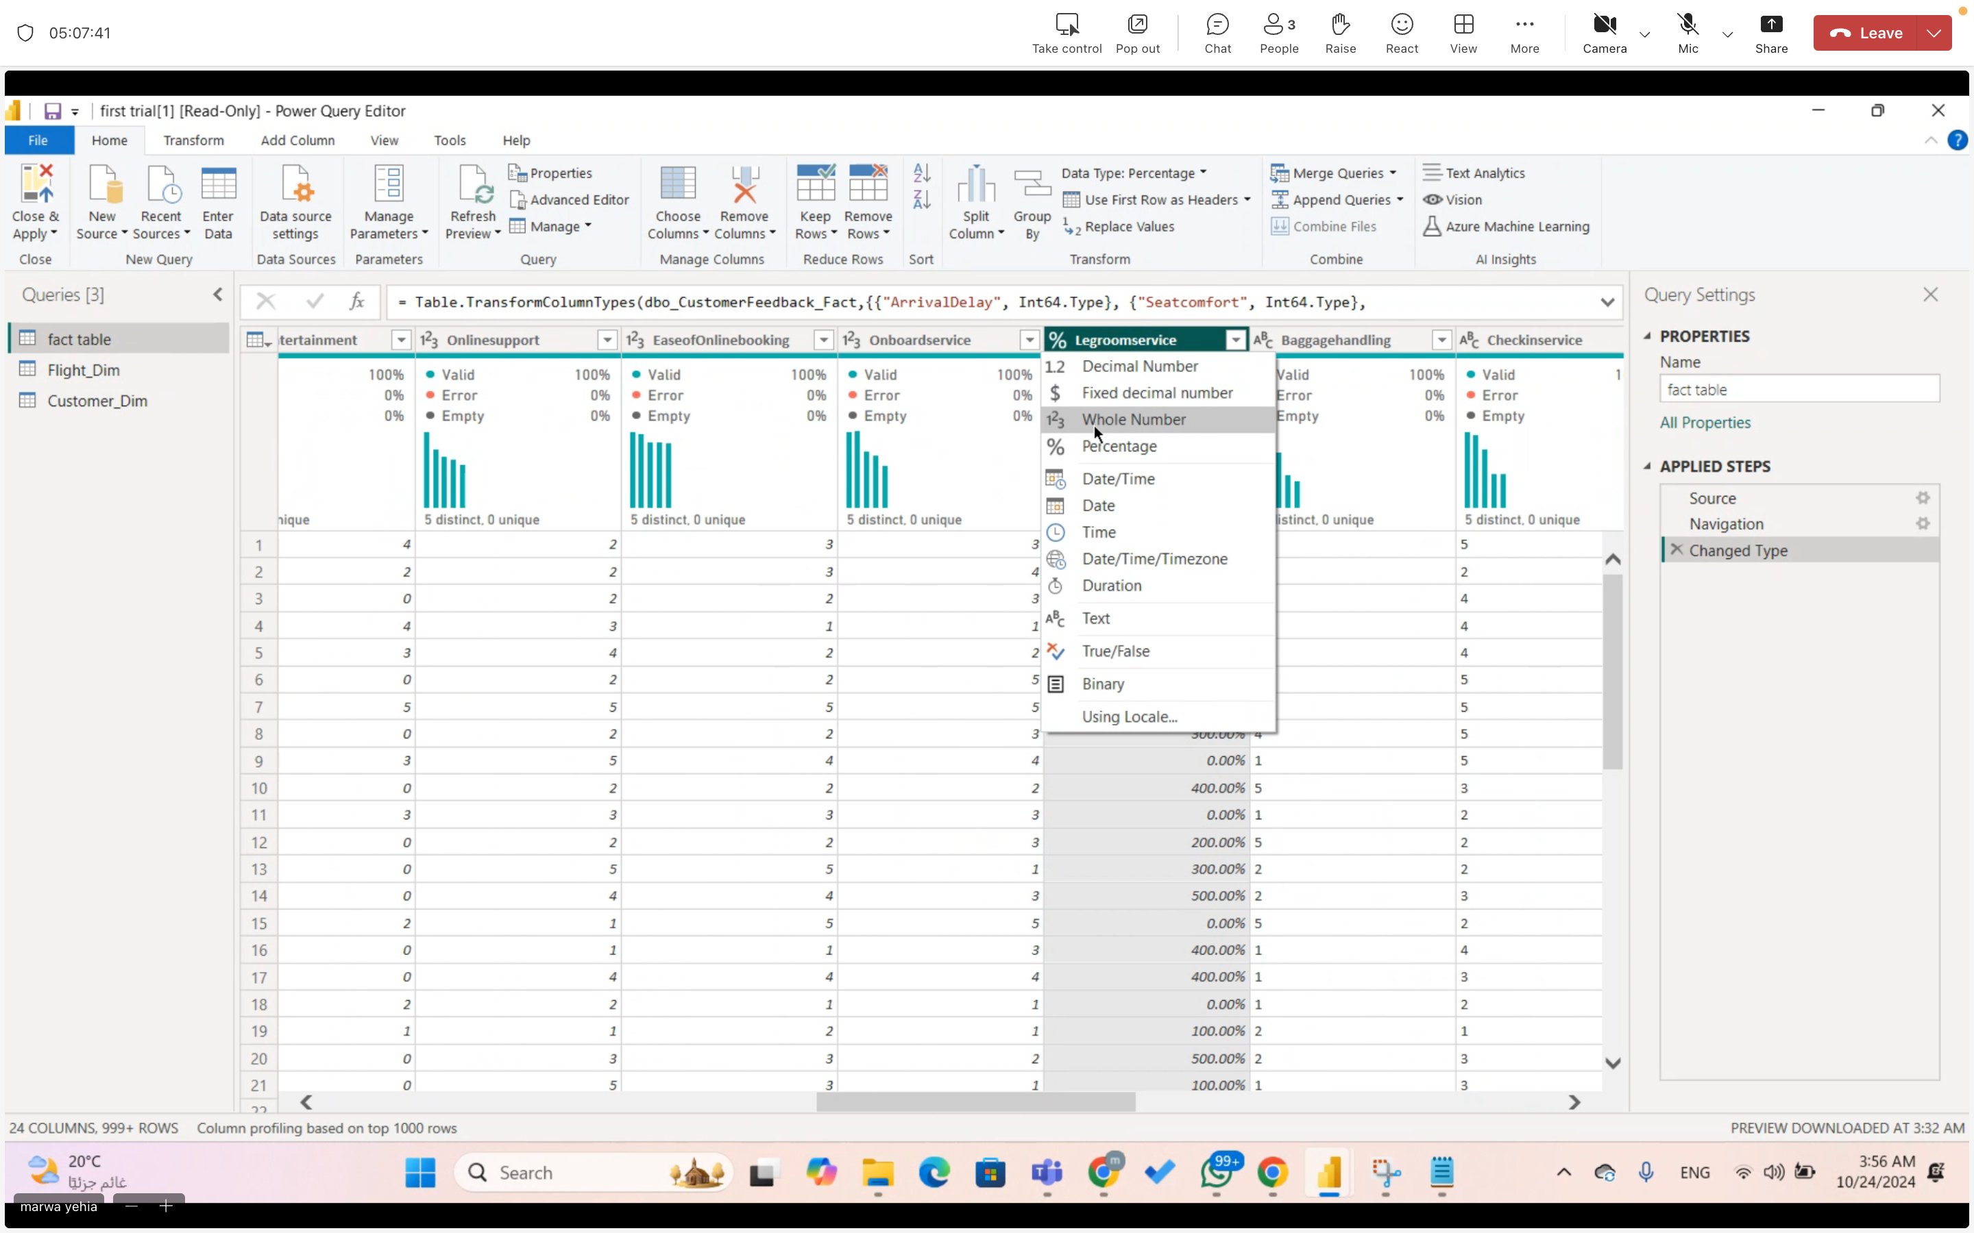
Customer Feedback Analysis and Improvement
Data Visualization
Power BI

Slide 19
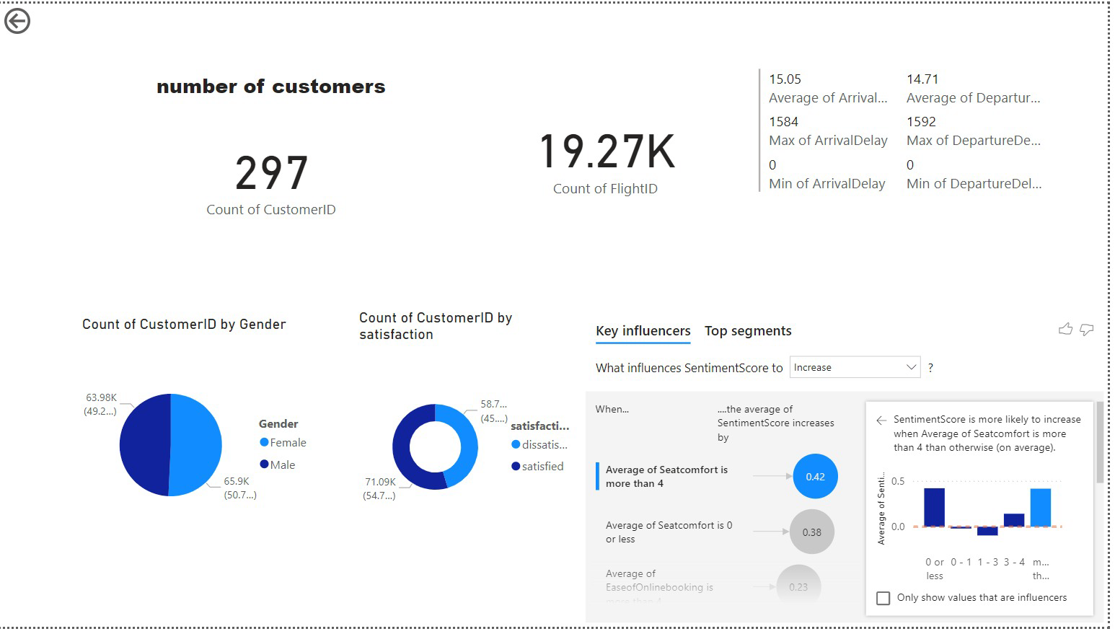
Customer Feedback Analysis and Improvement
Data Visualization
Power BI

Slide 20
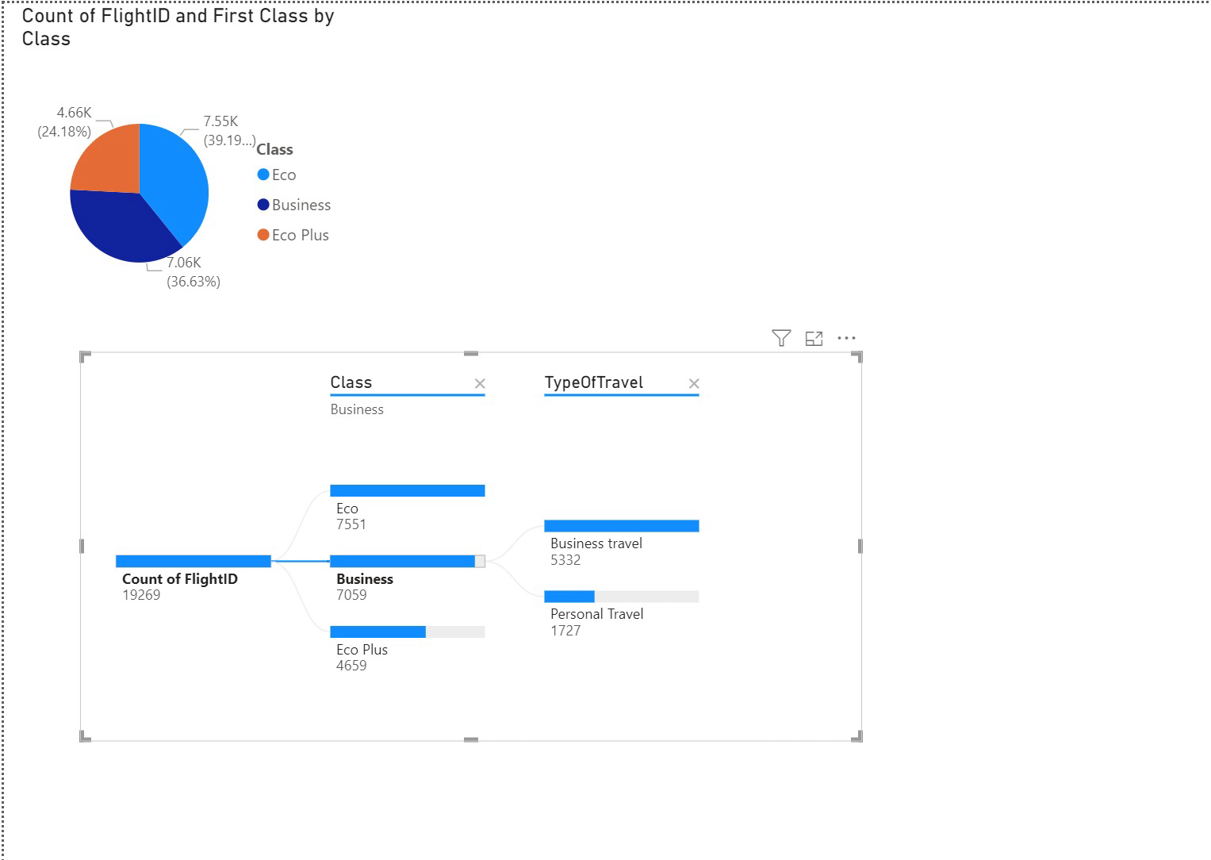
Customer Feedback Analysis and Improvement
Data Visualization
Power BI

Slide 21

Customer Feedback Analysis and Improvement
Special Thanks
Eng. Mahmoud Khattab
Digital Egypt Pioneers Initiative (DEPI)

